Slide 1
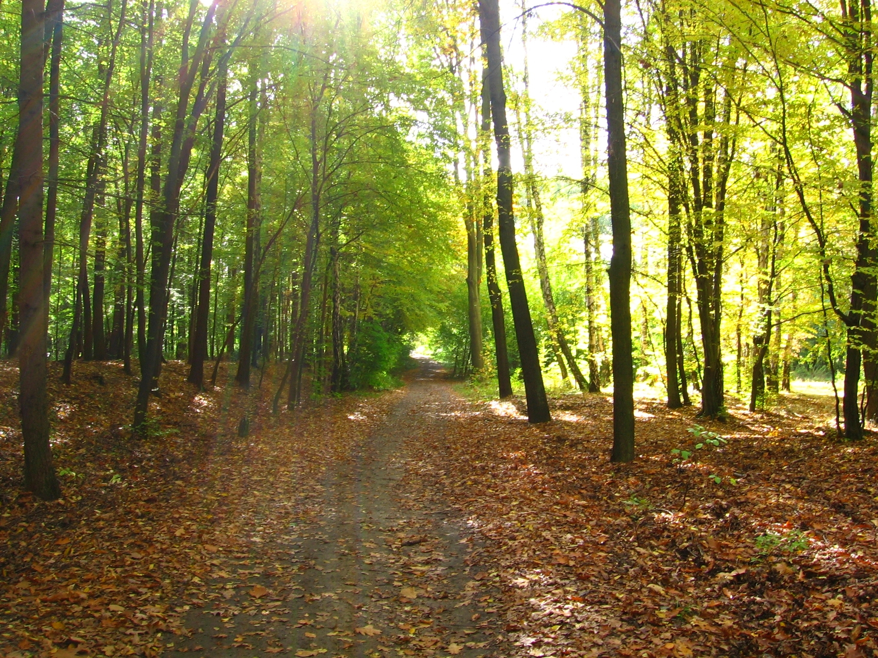
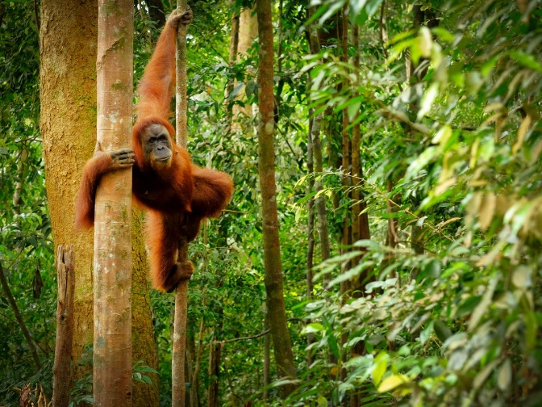
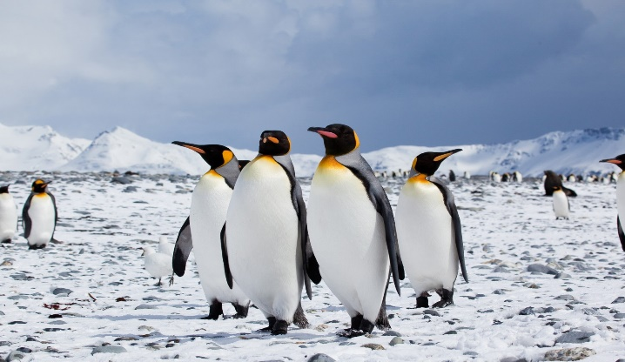

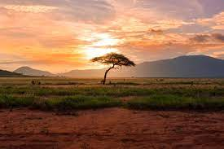

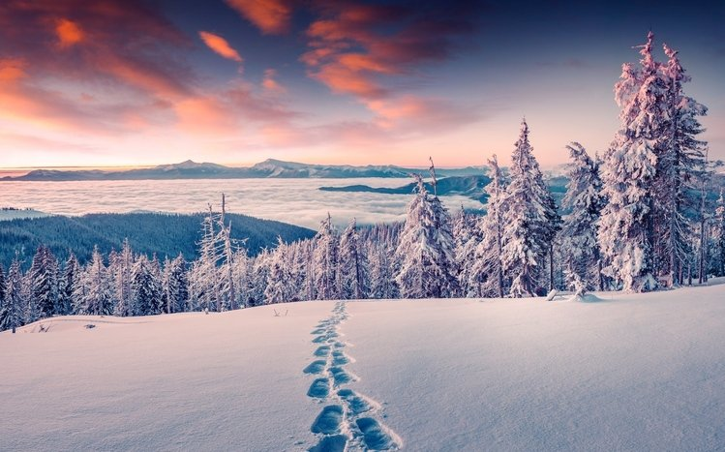
Change the story
Click on the slides to find out more about CLIMATE CHANGE……..

Slide 2
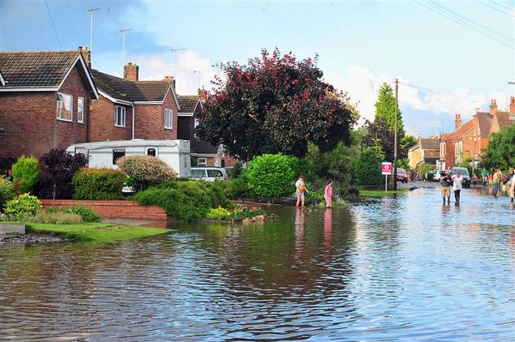
The problem
The brook is rising and going into peoples houses also not allowing us to go to school.
We should do something
About this. We should stop releasing carbon dioxide into the air because it is causing climate change.

Slide 3
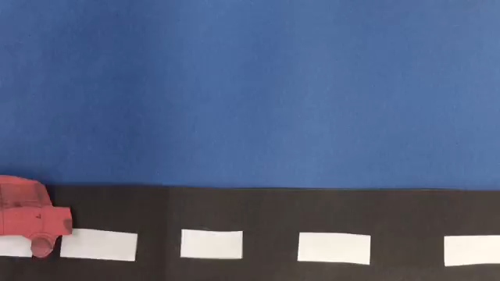
Video about climate change
THIS IS A VIDEO ABOUT CLIMATE CHANGE
Climate change is bad but we are causing it. We need to stop this.

Slide 4
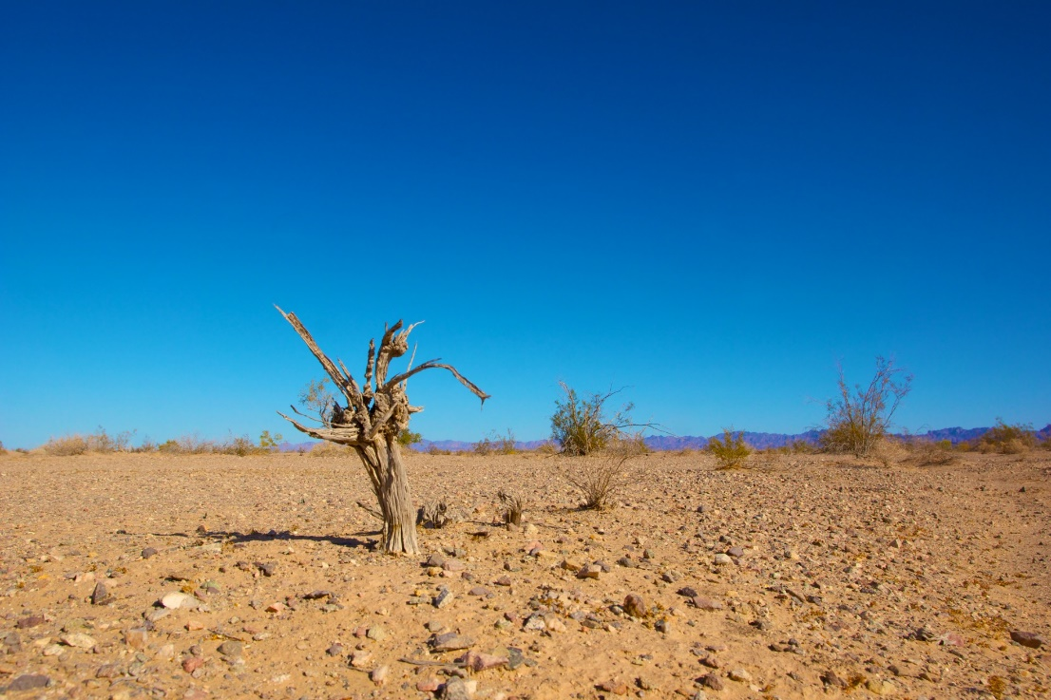
Consequences
Flooding
Crop failure
Ice caps melting
Animals becoming extinct and homeless
Forest fires
Land underwater/ water levels rising
Storms and severe weather

Slide 5
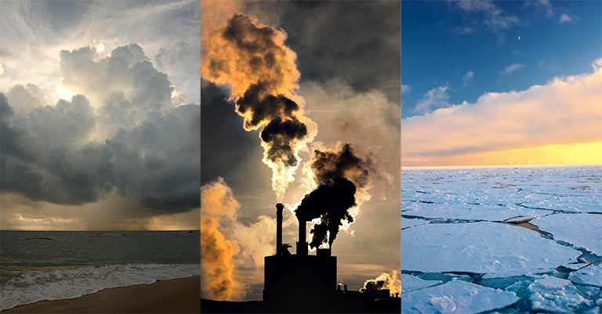
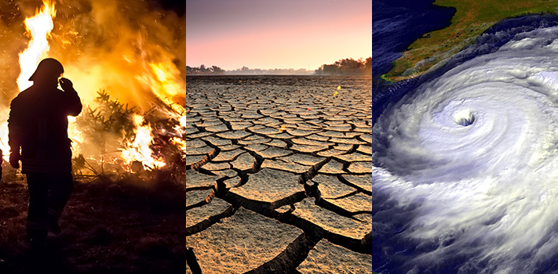
Climate change

Slide 6
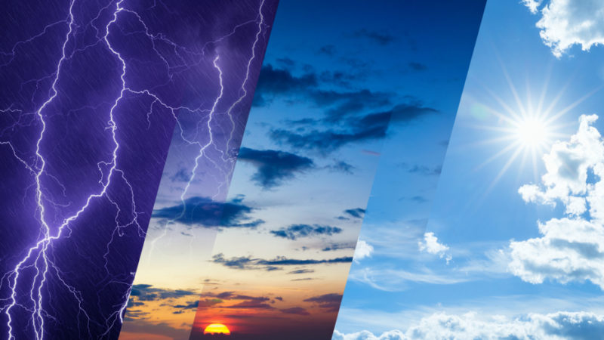
Solutions
More electric cars using renewable electricity
use solar panels
Eat more vegies
Insulate houses
Walk and recycle rubbish
Less meat
Conserve electricity

Slide 7
